Slide 1
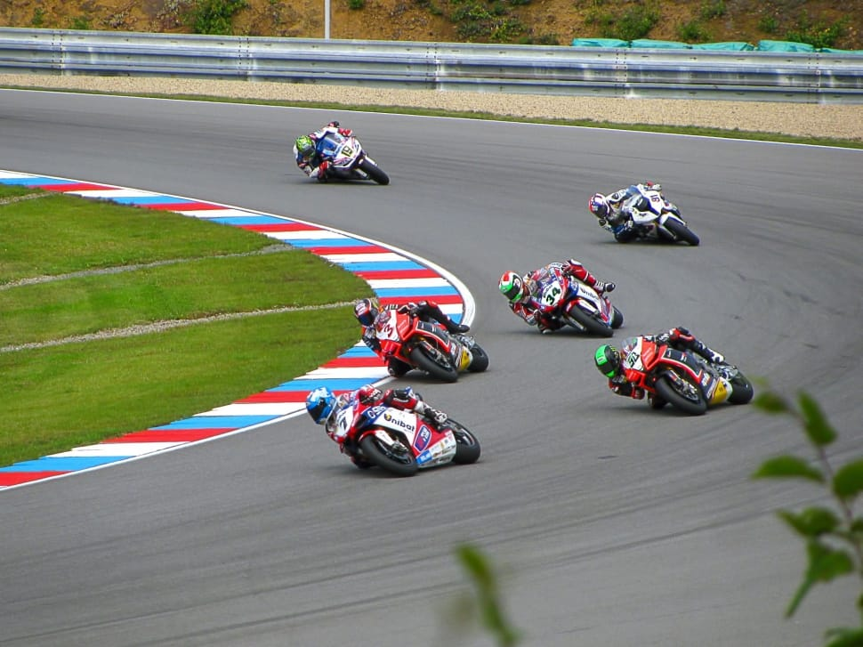
MOTOGP
ALBUM
By Group 6

Slide 2
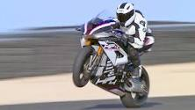
Notes:
A caual biker racing in a platform

Slide 3
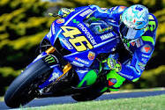
Notes:
Blue bike

Slide 4
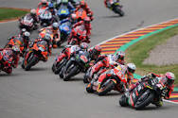
Notes:
Racing competition

Slide 5

Notes:
Red bike

Slide 6
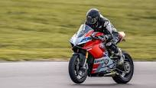
Notes:
Black Ninja

Slide 7
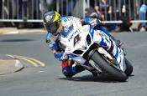
Notes:
Uphill racing

Slide 8
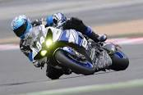
Notes:
About to skid

Slide 9
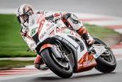
Notes:
A pro

Slide 10
Thankyou

